Slide 1

Book My Doctor
Presented By-
Rajat Aggarwal
Sai Teja.P
Khushbu Kumari

Slide 2
Book My Doctor
Introduction:
The project is to develop an online Doctor Appointment Booking System.
Book My Doctor is a health care portal that connects patients with doctors and provides information about medical requirement as and whenever required.

Slide 3
Book My Doctor
Problem Statement :
People are going to hospital to book an appointment with a doctor and has to wait so much time to get an appointment.
Even appointment has to entered in a register.

Slide 4
Book My Doctor
Objective:
To remove all the manual work of the patient and receptionist via console based application.
This will create a platform for patients which they can see the availability of doctor even doctor can update availability as per their requirement.

Slide 5
Book My Doctor
Implementation:
Functionalities of the system.
There are 3 types of users:
Admin
Doctor
Patient

Slide 6
Book My Doctor
Admin Module
Admin has overall control of the system.
The main features of admin module are given below:
Manage Appointments
Manage Patient
Manage doctors
View Appointments Statistics
Rating Details

Slide 7
Book My Doctor
Doctor Module
Easy and User Friendly Sign Up, Sign in
View Appointments
Can schedule their availability dates and availability times.

Slide 8
Book My Doctor
Key Features
Search Module
(searching a doctor for appointment)
Appointment Booking
Check- in form Submitting
Appointment Management
Schedule a timing (Leave or Vacation)
Past appointment Management
Ratings

Slide 9
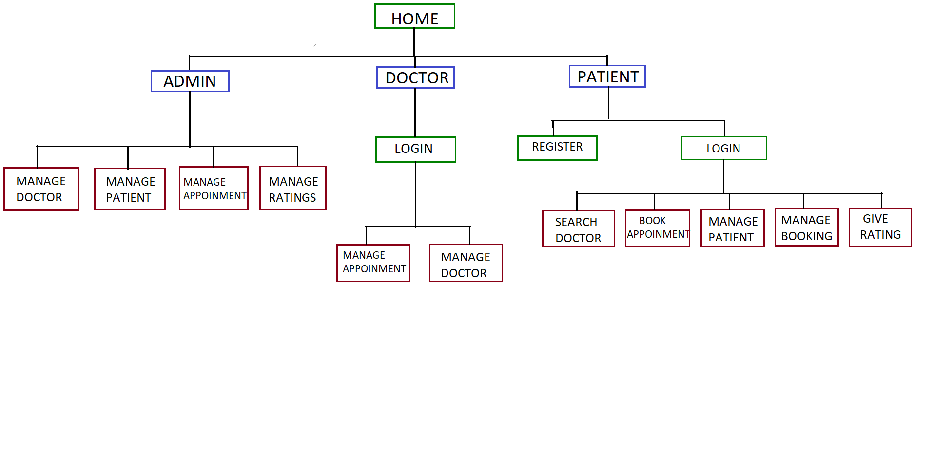
Book My Doctor Flow of Program:

Slide 10
Book My Doctor
Why LinkedList?
Java LinkedList class can contain null and duplicate elements.
Java LinkedList class maintains insertion order.
Java LinkedList class is non synchronized.
In Java LinkedList class, manipulation is fast because
no shifting needs to occur.

Slide 11
Book My Doctor
Technology Used - Java 1.8 (By Using Collection)
Tool Used - Eclipse .

Slide 12
THANK YOU

